Slide 1

Welcome to Seminar xx
Nima Fakoor

Slide 2


Enriching Feedback in the Primary Classroom by Shirley Clarke
Explain The author
Explain The book
Approach***
1
2
3

Slide 3


creating a learning culture in which effective feedback can exist
1
if pupils don't learn the way we teach ...perhaps we should teach the way they learn. /Eppig
Introduction & preface
What or How ??? ☺
2
3

Slide 4
Scientific Theory about #Teaching and #Learning Based on :
FA
Formative Assessment
EF
Effective Feedback

Slide 5

Constructivism Classroom
General Explain
Establishing Discourse in the Math Classroom
1
2

Slide 6
#Learning Constructivism Classroom belong the :
Co-ops
Qo-c
Discuss
Expl&dico
meanCon

Slide 7
Maths & Constructivism Video

Slide 8
the most important single Factor influencing learning is what the learner already knows . ascertain this is and teach him accordingly.
“ Ausuble

Slide 9

Pre-Discussion

Slide 10
Other Specific Examples of Constructivist Methods:
1. ILPE method* (investigating learner’s previous experiences)
• Teacher leads students to brainstorm an idea to allow the teacher to assess prior knowledge.
2. Deductive concept method*
• Teacher defines concept and leads students to give examples and non-examples.
3. Inductive concept method*
• Examples and nonexamples are given and the teacher leads the students to a conceptual definition.

Slide 11
Other Specific Examples of Constructivist Methods:
4. Directed discussion method*
• Focus on teacher-student interaction. Series of questions related to materials facilitate students’ grasp of one or more principles.
5. Exploratory discussion methods*
• Focus is on student-student interaction. Teacher mediates a discussion between students that explores different view points based on documentation. May include role play.
6. The Information Construction (ICON)
** model contains seven stages

Slide 12
The Information Construction (ICON)** model contains seven stages:
1. Observation: Students make observations of primary source materials embedded in their natural context or simulations thereof.
2. Interpretation Construction: Students interpret their observations and explain their reasoning.
3. Contextualization: Students construct contexts for their explanations.
4. Cognitive Apprenticeship: Teachers help student apprentices master observation, interpretation, and contextualization.
5. Collaboration: Students collaborate in observation, interpretation, and contextualization.
6. Multiple Interpretations: Students gain cognitive flexibility by being exposed to multiple interpretations from other students and from expert examples.
7. Multiple Manifestations: Students gain transferability by seeing multiple manifestations of the same interpretations.

Slide 13
Comparing : Traditional Teaching & Constructivism Video

Slide 14
Formative Assessment is : Brook and Brook
AIP
SAL
S-A
AdjR
PFL
E-Q
CSI
Dependency of CC to FA (Blak & Wilam 1998)

Slide 15
Why Formative Assessment
Formative Assessment
Long Learning
Formative Assessment in #Exercise and this Like a #Travel …

Slide 16

BUT, LOCK DOWN
Some Teachers Resistance
Because They Think or Belief :
Tradition
No belief
Satisfied
Losing control
1
2
3
4

Slide 17



The Way…
1
2
3
Release systematic
Control of classroom
Better activity
Classroom Management Strategies To Take Control Of Noisy Students

Slide 18
Brook & Brook 1993
#Teaching Behavior in Constructivism Model

Slide 19

1 Initiative autonomy students

Slide 20
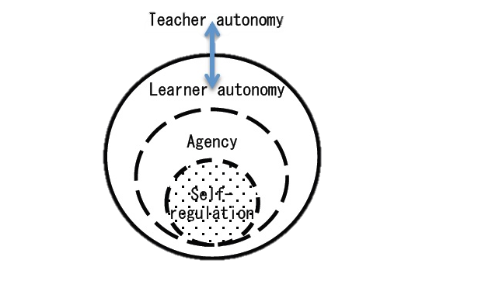
Autonomy & Examples

Slide 21
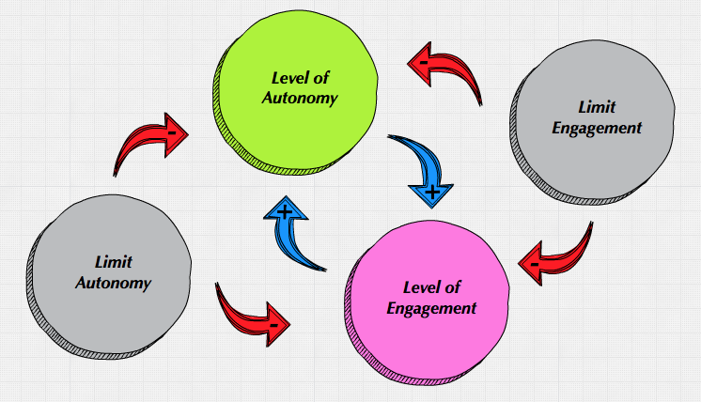

Slide 22

2 Look Evidence

Slide 23
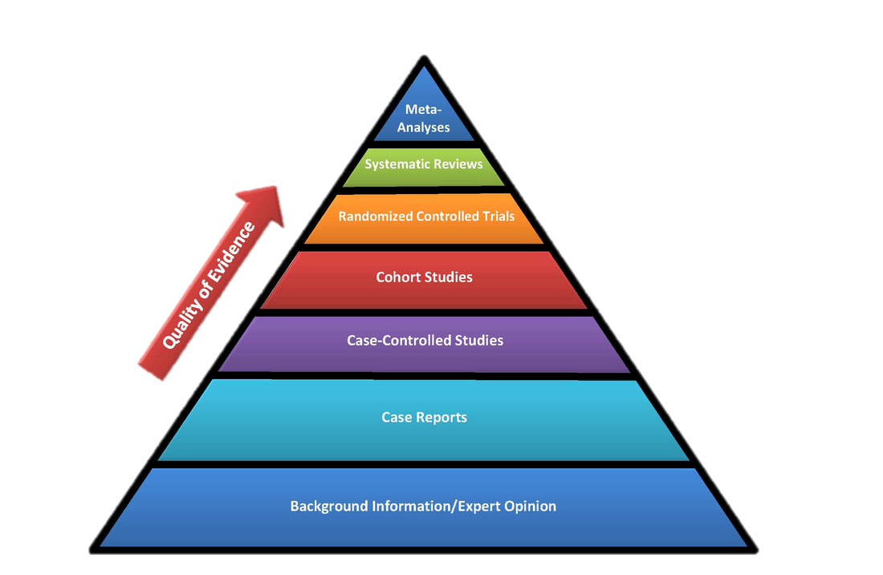
Evidence Pyramid

Slide 24

3 Cognitive Terminology

Slide 25

Pre-Discussion Platonic Academy

Slide 26
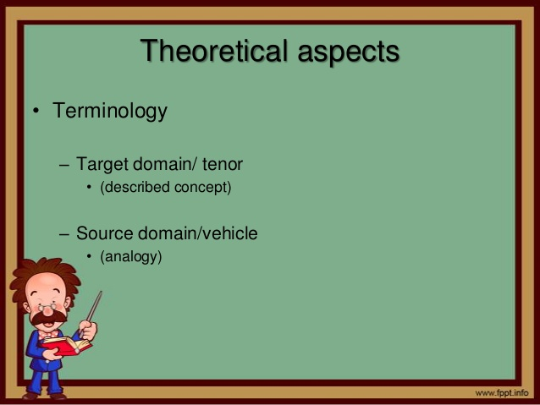
saying what you mean, and meaning what ...

Slide 27

4 Allow Students

Slide 28
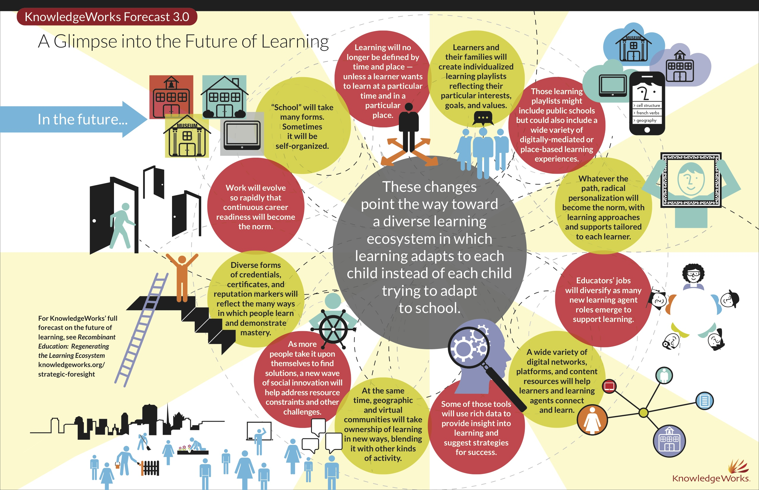
Across countries, states or regions, next generation elementary and secondary education systems will share ten elements: 1. Goals. Next-generation learning systems will set goals that focuses resources and behaviors on productive habits of success and preparation for participation in college, careers, and civic life. Good goals can encourage Deeper Learning and clarify intent. Next-gen systems will have standards that express in some detail what students should know and be able to do—more detailed in literacy and numeracy; more general when it comes to dispositions and experiences. They will not include checklists of content knowledge. 2. Assessments. Next-gen systems will use a few common assessments including secondary end of course exams (or demonstration opportunities) available on demand. Providers in next-gen systems will use lots of experience embedded assessments to calculate comparable growth rates. Without heavy weight end of year assessments, it will be easy to determine academic levels and growth rates for each learner in real time. 3. Authorizing. In a next-gen system, all full and part time providers will operate under a performance contract—perhaps three years, longer for proven providers. A well developed provider authorization process would ensures that every family has access to a variety of quality blended and online full and part time options. Most providers would benefit from perpetual rather than political leadership with a board committed to a mission (i.e., nonprofit and for-profit corporations). A proactive authorizer seeks providers to address gaps and take advantage of opportunities. For example, the Indiana Charter School Board issued a request for applications that invites new models with strong potential to accelerate student success including those that use “staff roles, technology, compensation structures, and/or other aspects of school design and/or implementation to enable the school to reach more students with excellent teaching” in a financially sustainable model. Next-gen authorizers will use multiple application pathways for new, innovative, high performing, turnaround, virtual, special services, and conversion providers. (For more on governance, see NCEE’s Tough Choices of Tough Times and Fordham’s report on governance.) 4. Personalized learning. Next-gen systems will power personalization with portable learning plans, transcripts and portfolios. A decade ago it became widely recognized through the success of a new generation of charters that a coherent model–where everything works together for students and teachers– was key to consistently high achievement. That coherence was usually expressed in high expectations, standards-aligned instruction, formative assessment, and lockstep cohort progress. The next-gen opportunity is a coherent personalized learning experience—individual learning pathways where all the pieces feel purposeful and connected. Learners will traverse the next-gen multiple provider landscape with Data Backpacks: Portable Records & Learner Profiles and benefit from the sustained relationships of an advisory as well as: Single application and enrollment process (e.g., New Orleans’ OneApp) Online guidance services (e.g., Louisiana Course Choice) Portable digital portfolio (e.g., eduClipper, Pathbrite) 5. Data systems. Next-gen systems support portability, transparency, and accountability with comprehensive longitudinal data systems—that starts with the 10 Elements and Actions of the Data Quality Campaign. As noted in #2 and #4, next-gen systems should provide frameworks for measuring academic growth rates of individual students and facilitate sharable learner profiles and portfolios. 6. Funding. As detailed in Funding Options, Students, and Achievement, next-gen systems will provide weighted, flexible, portable funding. 7. Talent. Next-gen systems will support multiple preparation pathways and certify based on performance. High potential leadership candidates should have access to a variety of developmental experiences and learning opportunities. Next gen schools will recruit, develop, and leverage the talent of great teachers. They will use differentiated roles from assistant to master teacher and will make use of some part time specialists at a distance. See OpportunityCulture.org for 10 specific models of extended reach. 8. Connections. Next-gen systems help secondary students experience success in college, careers, and community service. Post secondary connections will include free competency-based higher education options and access to job training programs as part of or after secondary education. 9. Support. Next-gen systems will connect students to a web of support services for youth and families by partnering with groups like Community In Schools. 10. Accountability. Next-gen systems will actively intervene in chronic failure. Like the Louisiana RSD and the Michigan EAA, the Tennessee Achievement School Districtis the state turnaround district and it’s posting promising results. The 10 Elements of High Quality Digital Learning from Digital Learning Now! provide additional policy guidance for next-gen systems.

Slide 29
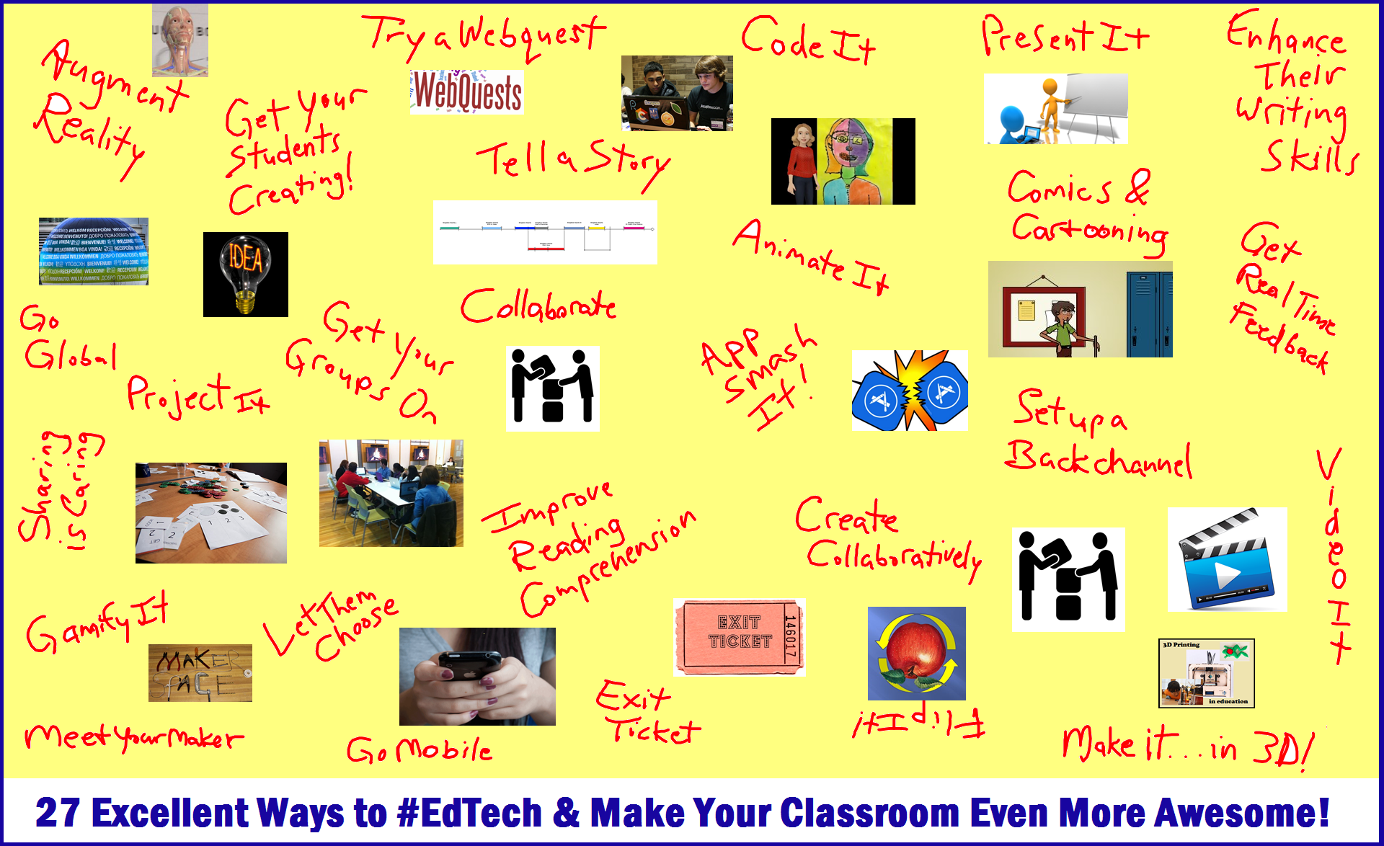

Slide 30
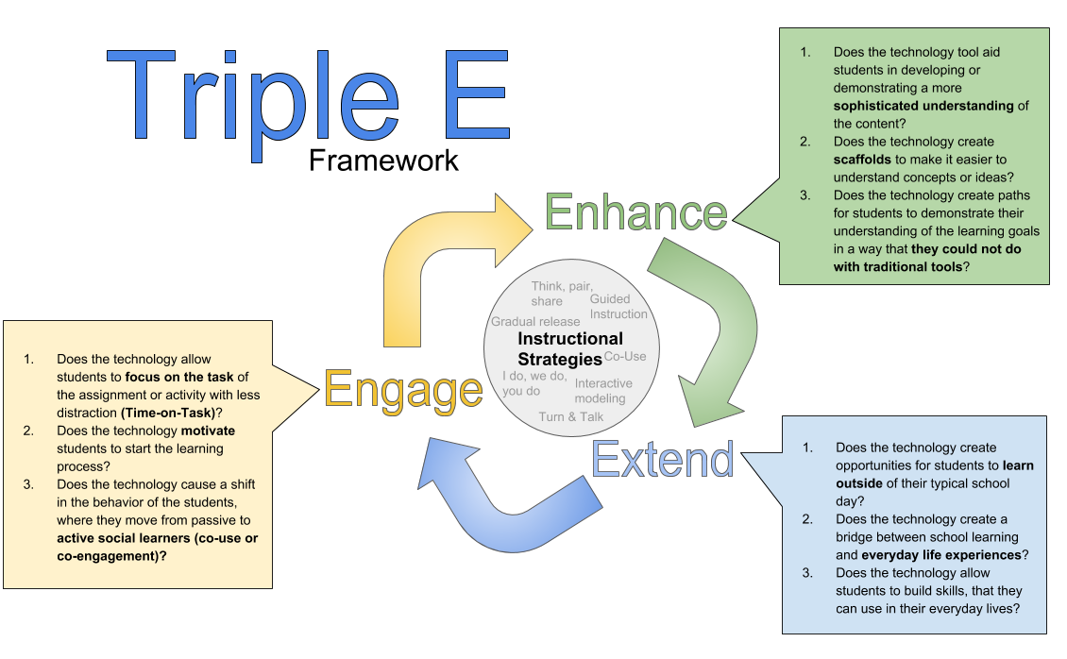

Slide 31
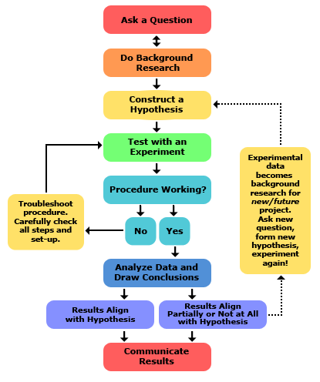
Teacher Inquire

Slide 32
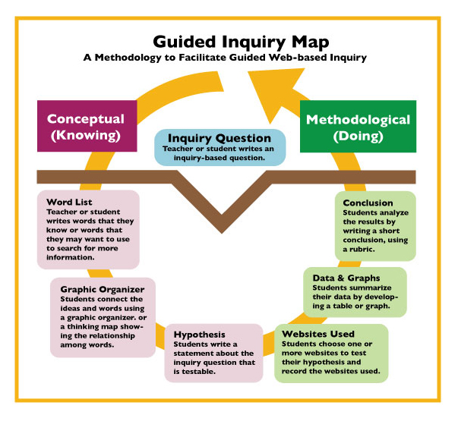
.

Slide 33
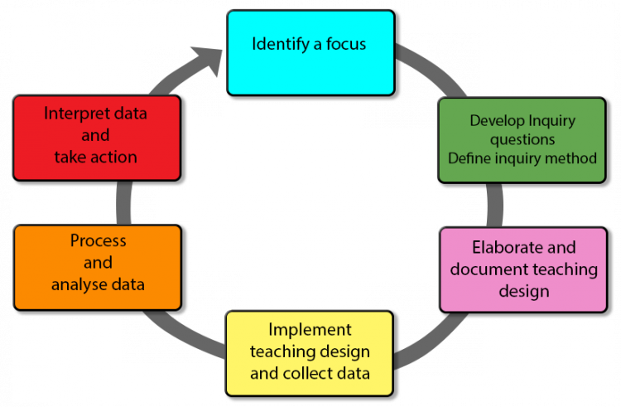

Slide 34

Engage in Dialogue

Slide 35
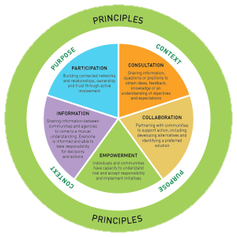

Slide 36
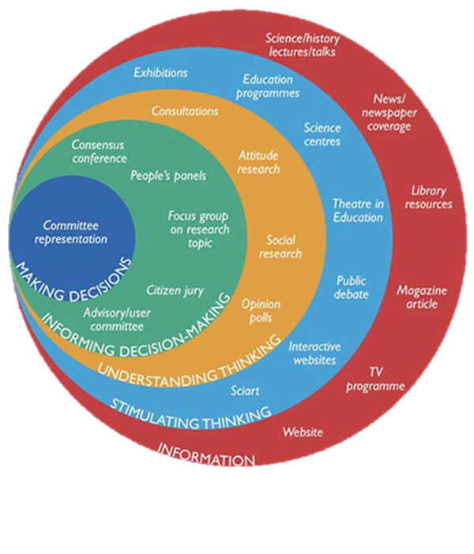

Slide 37


Asking Thoughtful

Slide 38
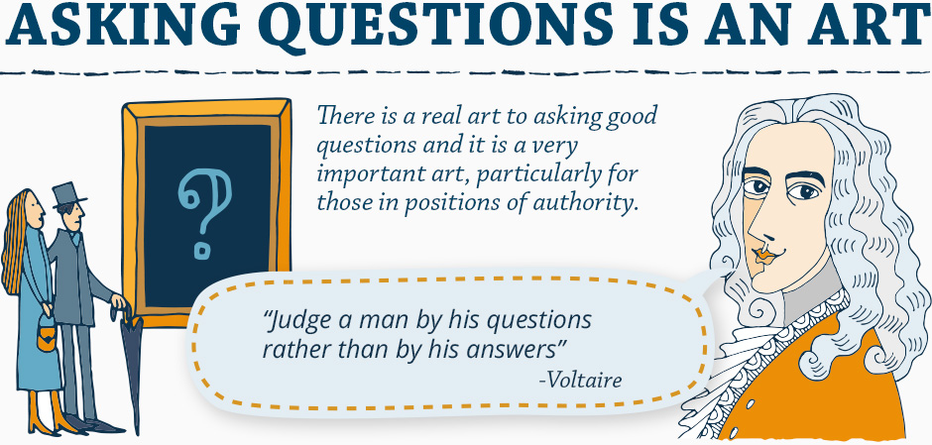
Art of Asking Truth Questions

Slide 39

Art of Asking Truth Questions

Slide 40

Art of Asking Truth Questions

Slide 41
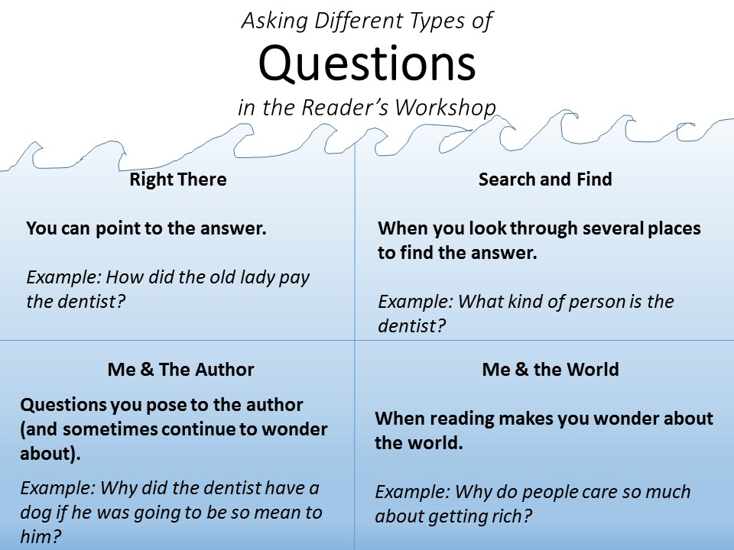

Slide 42
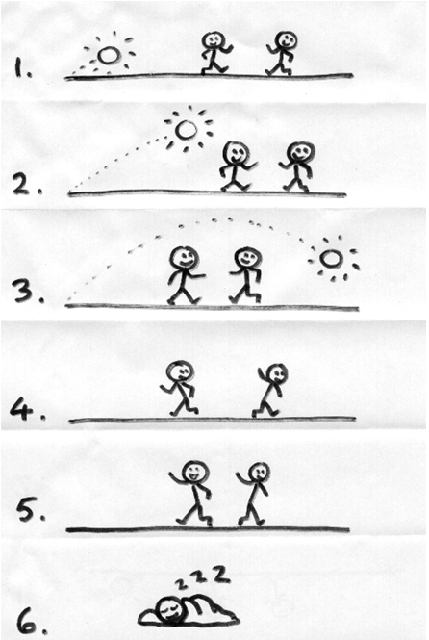

Seek Elabration

Slide 43

True Q&A

Slide 44


Might Engend contradiction

Slide 45
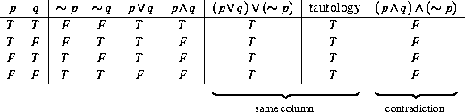

Slide 46


Time Asking

Slide 47


EMERGENCY
1
2
Don’t Move quickly
Know the safety zone of pupils

Slide 48
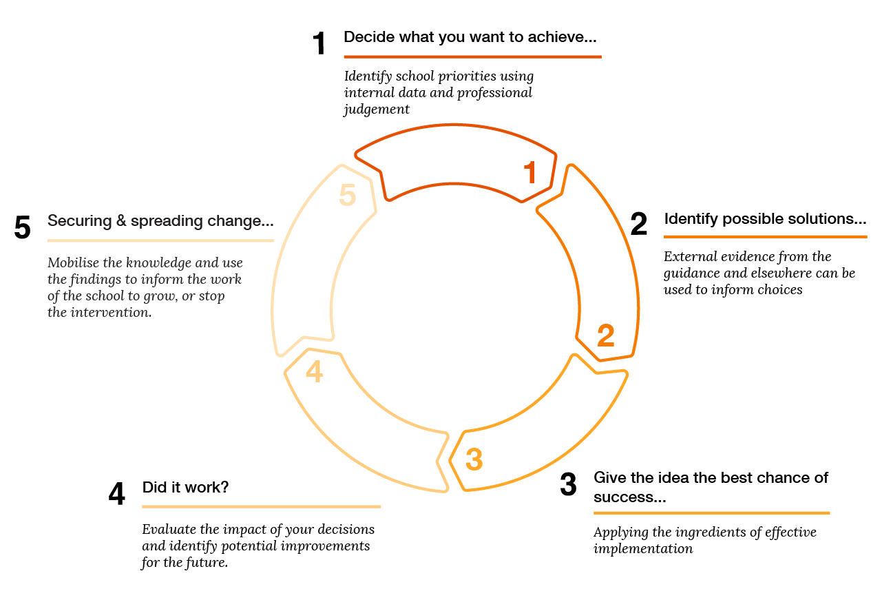

Slide 49
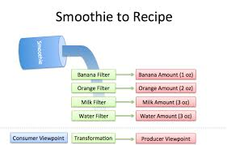
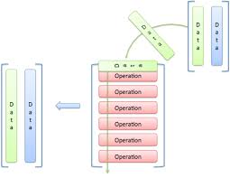
Cheat Metaphors

Slide 50
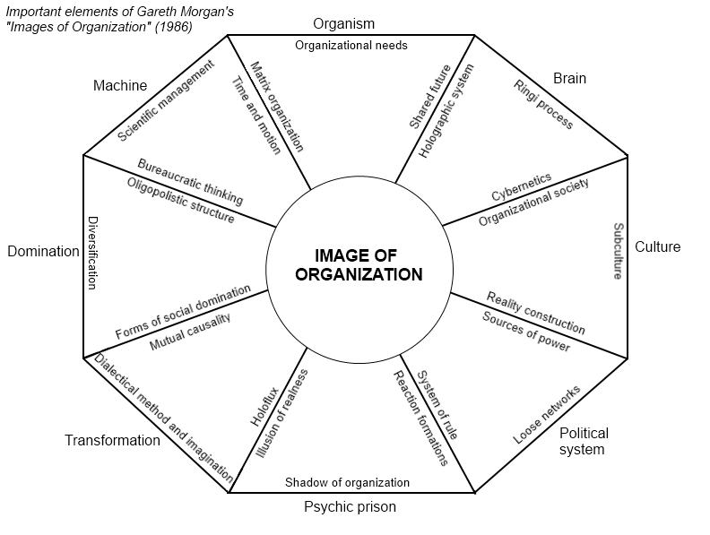
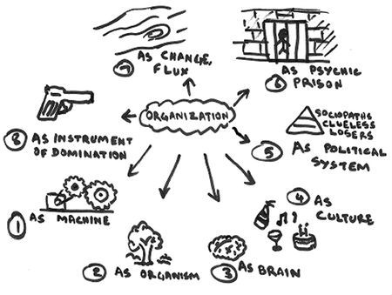
Cheat Metaphors

Slide 51
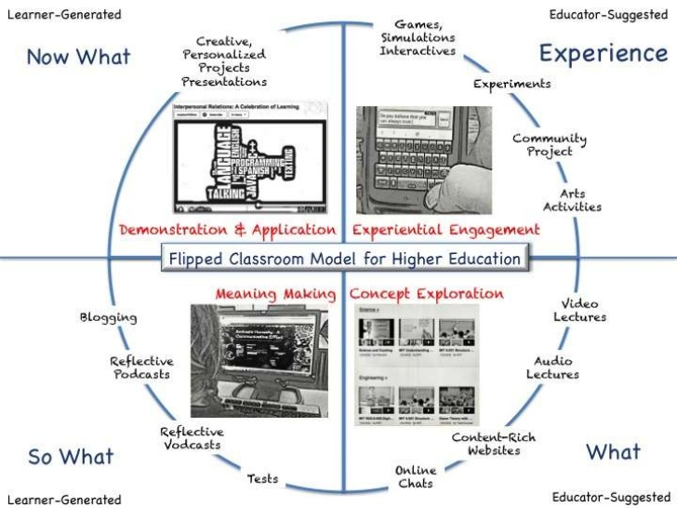

Slide 52

Natural Curiosity

Slide 53


Slide 54
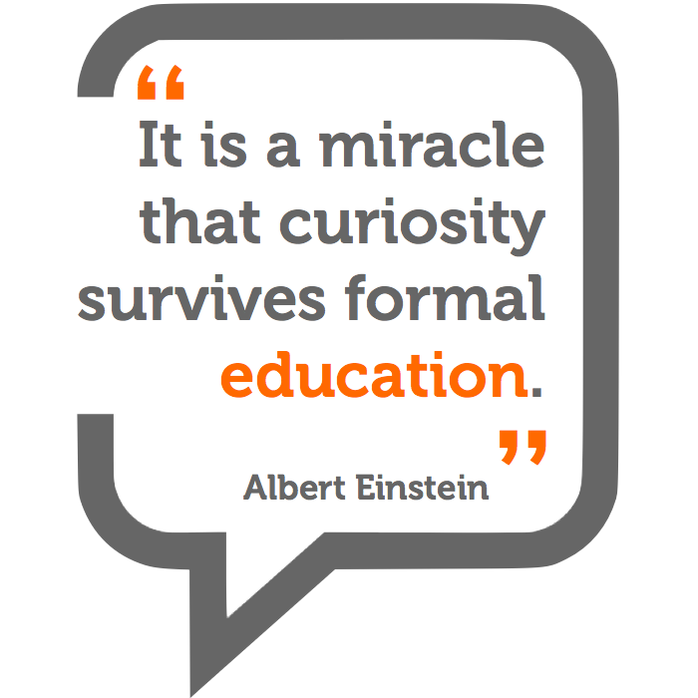

Slide 55
Learning Cycle
Attraction
Focus
Application

Slide 56

این چرخ فلک که ما در او حیرانیم فانوس خیال از او مثالی دانیم خورشید چراغ دان و عالم فانوس ما چون صوریم کاندر او حیرانیم #خیام

